Slide 1
Materiel Readiness Training Cell (MRTC)
Maintenance Management Supervisor Course (MMSC)
Calibrations Program

Slide 2
Overview
The purpose of this class is to familiarize you with the Marine Corps Calibration Control Program and how it functions in GCSS-MC

Slide 3
Topics
Program Requirements
Responsibilities
Calibration Categories
PM/Cal Scheduling Form
Calibration Service Request
Calibration Report
External Calibration Programs

Slide 4
Calibrations Program
Questions ?

Slide 5
Calibration Program Purpose
Method of exercising control over the unit’s calibration program for test, measurement, and diagnostic equipment (TMDE)

Slide 6
Calibration Program Criteria
Criteria: Items will have an Operational Test Code (OTC) of 3 in the GCSS-MC Item Master Organization (IMO) attributes

Slide 7
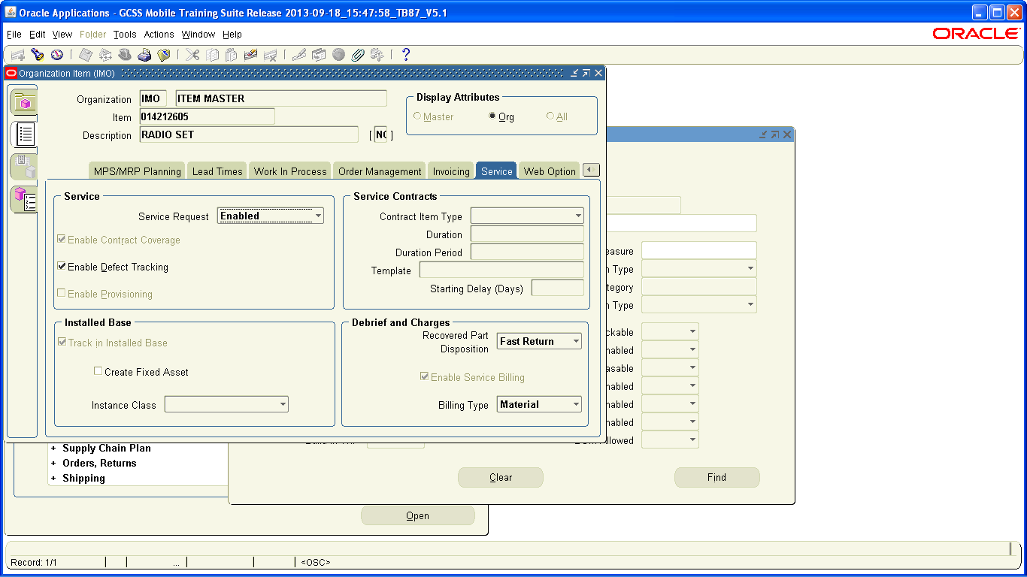
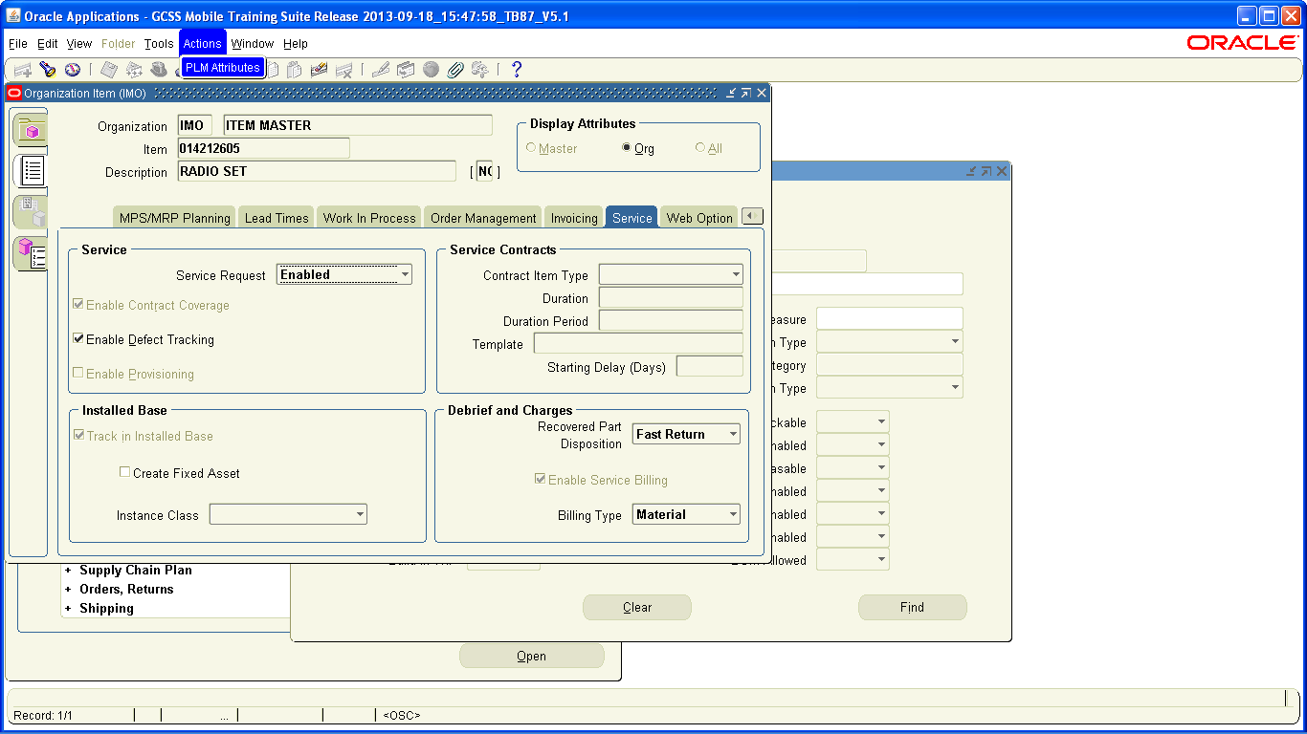
Organizational Items

Slide 8
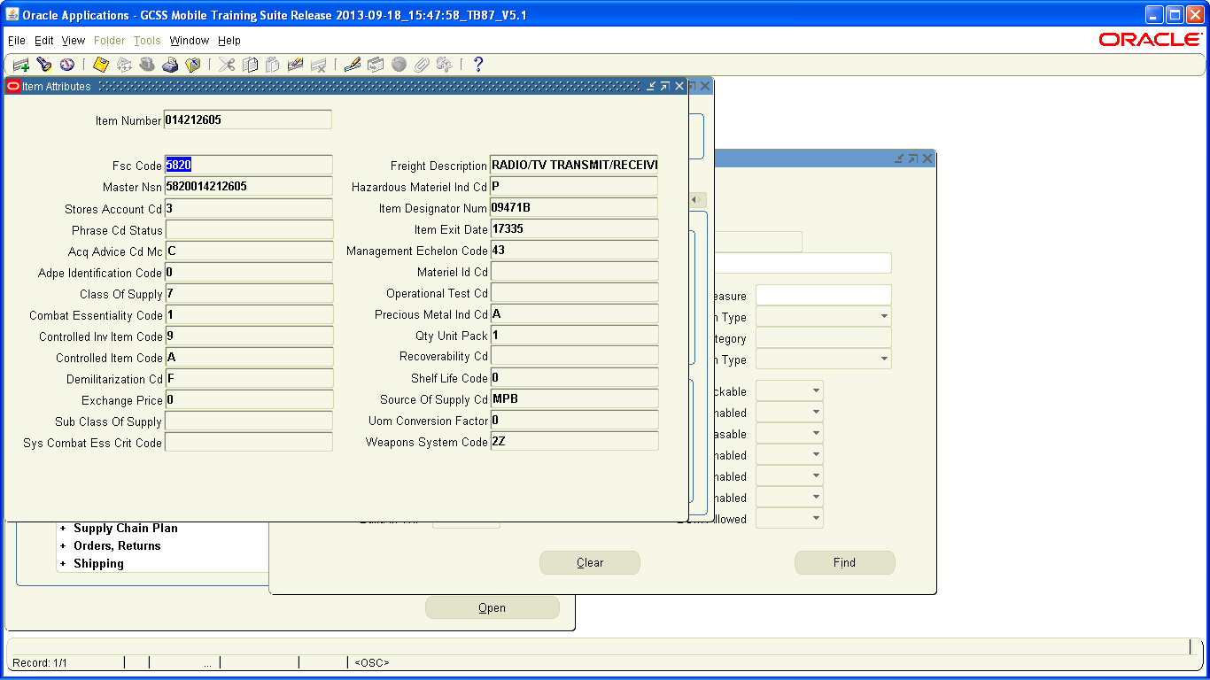
Organizational Items
3

Slide 9
Incorrect TMDE IMO Attributes
In the event that you have TMDE that requires Calibration but does not have an OTC reading you must request an Item Master Organization (IMO) load
Identify Monthly Field Change requirements(IMO attribute correction process. Identify GPN 1-14, MFC playbook on the LPC SharePoint, and the spreadsheet of affected NIINS and unit required actions?)
Notes:
Request MUST be submitted per instructions below:
USE A NAVMC 11862 FORM.
******ONLY 1 IMO LOAD REQUEST(1 NIIN )PER SERVICE REQUEST******
-PLEASE FOLLOW THE DIRECTIONS ON PAGE 2 OF THE NAVMC 11862 REQUEST.
-PROCESSING CAN NOT OCCUR IF REQUIRED INFORMATION IS NOT INCLUDED.
-ENSURE ALL END ITEM INFORMATION IS COMPLETE.
The process to get a NIIN loaded into GCSS-MC IMO is to first contact the SMU. The SMU will look to see if it exists in the GCSS-MC Item Master (IMO) and if it is added to your Inventory Organization.
If the NIIN does not exist in the Item Master, the SMU will have the unit complete a NAVMC 11862 (CATALOGUE REQUEST). The SMU will create a Service Request, attaching the NAVMC 11862 FORM COMPLETED BY THE UNIT. The Service Request OWNER will be the GROUP "M38001_LCC_LSD_RETAIL". LCC/Retail Systems Branch will validate the data submitted on the SR/NAVMC 11862. If corrections are required the SR is returned to the SMU with an explanation of discrepancies. Once validated by Retail Systems Branch, the SR/NAVMC 11862 is passed on to the “M38001_PSC” group, who will then have the respective Equipment Specialists review the request.
NOTES:
The determination of whether an item is serial managed is in MCBUL 4130: MARINE CORPS SERIALIZED ITEM MANAGEMENT (SIM) Policy.
With that being said, currently the Serialized Item Flag in GCSS-MC cannot be changed if items are on hand in inventory. The GCSS-MC Program Office is working a fix, and when it is implemented, a Naval Message will be sent out.
The inability of being able to change the Serial Flag is mostly affecting component items that require Calibration, AND items that need to be added as Child components to an End Item.
For all sub-components of Principle End Items(PEIs) that require CAL (Operation Test Code(OTC-3) in FEDLOG) use the procedures outlined in GPN 4-12, which also details how to assign a GCSS-MC generated SN# for items that do not have an OEM or USMC SN#.
The GPN 4-12 process will only work if the NIIN is resident in the IMO, is Active, and has the Serial Flag set to “At Receipt” (serial controlled).
The below are examples of the desired Service Request format for IMO Load Requests.

Slide 10
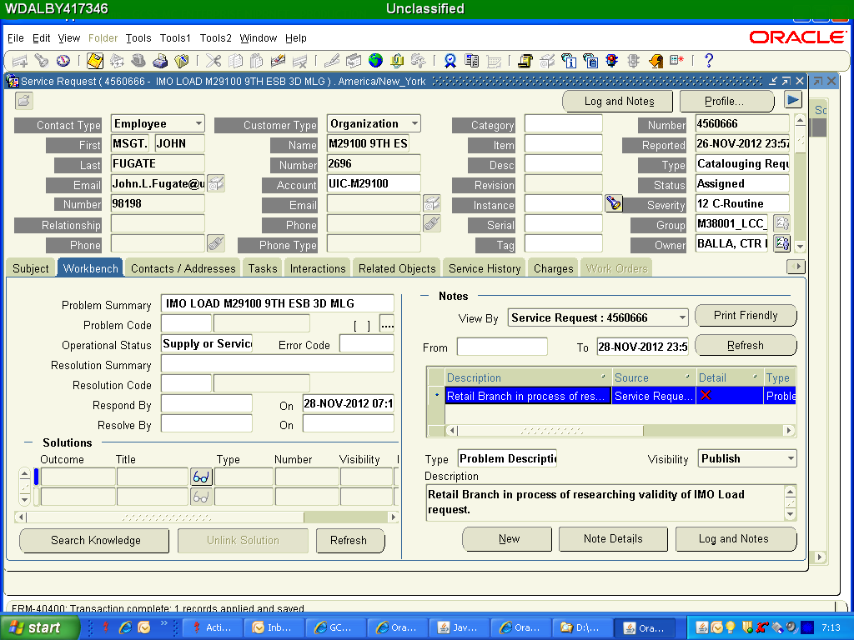
IMO Load SR Example
Notes:
Create a Cataloging Request SR
Ensure that all the require information is filled in
-Organization
-POC
-Group (Your SMU)
-Problem Summary
-Operational Status

Slide 11
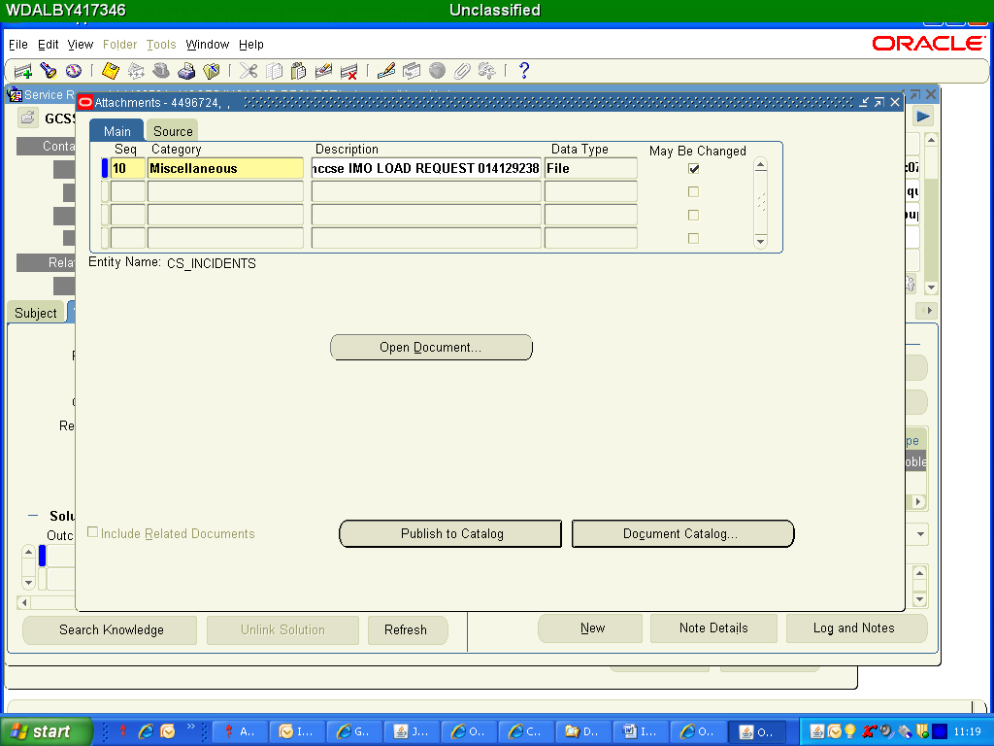
Item Master Organization (IMO) Load
Notes:
Any information to support your IMO load would be helpful and can be attached directly to an SR. As you can see we loaded a copy of the IMO Load Request

Slide 12
Item Master Organization (IMO) Load
Notes:
After you have attached supporting or requesting documentation the SR the paper clip icon show a slip of paper indicating that a document is attached to the SR.

Slide 13
Parent-Child Relationships
GPN 4-12 paragraph 7.b.3 provides guidance on how to establish parent-child relationships for Military Equipment with TMDE-designated child items.
Notes:
7.B.3. TMDE COMPONENTS OF A ME. TMDE ITEMS THAT ARE COMPONENTS OF A ME WILL HAVE THE PARENT/CHILD RELATIONSHIP CREATED WITHIN THE INSTALLED BASE BY DESIGNATING THE TAMCN/NIIN FOR THE PEI SET, KIT, OR OUTFIT (SKO) AS THE PARENT AND THE SERIALIZED TMDE COMPONENT AS THE CHILD. THE ORGANIC MAINTENANCE UNIT WILL COPY THE SERVICE REQUEST AND ASSIGN THE COPIED SERVICE REQUEST TO THE SUPPORTING CALIBRATION LAB. UNITS WILL UTILIZE THE GCSS-MC SERIAL NUMBER GENERATION FUNCTION TO ASSIGN A SERIAL NUMBER FOR ALL OTC-3 TMDE ASSETS WHERE A USMC/MANUFACTURER SERIAL NUMBER DOES NOT EXIST, BUT IS REQUIRED IN ORDER TO CREATE THE PARENT/CHILD RELATIONSHIP.

Slide 14
Calibrations Program
Questions ?

Slide 15
Responsibilities
Commanders
  Establish control procedures for sets, kits, outfits and tools (SKOT), and TMDE calibration per the references
Unit MMO
  Establish and maintain Calibration Control Program
  Balance TMDE control and access as well as calibration and operational requirements
Responsible Officer
  Initiate actions to correctly configure parent-child relationships, add items to a CMR, or load items into GCSS-MC via the appropriate reference

Slide 16
Responsibilities
Identify
  Unit MMO and Maintenance Personnel identify all Unit-authorized TMDE using the unit’s T/E, CMR, and allowance list
Locate
  Physically verify TMDE items and calibration control records
Inventory
  Match equipment, calibration control records, and unit T/E / allowances to ensure complete accountability

Slide 17
Responsibilities
Schedule
  Establish calibration due dates
  Ensure sufficient assets available for operational requirements
Inspect
  Ensure equipment requiring calibration is properly labeled and calibration status is current
Track
  Annually evaluate/ensure TMDE is correctly categorized and required for the unit’s mission

Slide 18
Calibrations Program
Questions ?

Slide 19
Calibration Program Requirements
All TMDE must be in one of four calibration statuses, (or it must be “rejected”)
  Full calibration required
  Special calibration required
  Calibration not Required
  Inactive Equipment
Equipment with a current calibration status
  Units will utilize GCSS-MC to track / schedule items for calibration
  Manual tracking of calibration data is required for incorrectly cataloged items

Slide 20
Calibrations Program
Questions ?

Slide 21
PM/CAL Scheduling Form
PM/CAL Scheduling Form
1
3
2
2
3
Maintenance-PM
Service Request
Maintenance-CAL
Service Request
4
4
PM Report
Cal Report
Notes:
There are three parts to the PMCS process inside of GCSS-MC.
This is a visual depiction of these three parts of the GCSS PMCS function.
The Marines will have to know how to use all three parts to be successful
We need to stress that all three parts are necessary IOT make the system work for the Marines
Need to emphasize the importance of entering all necessary equipment on the PM/CAL scheduling form and establishing the baseline information.
It is critical that your Marines understand how these three components of PMCS inside GCSS-MC work together.
The process they need to understand:
All equipment is entered on the PM/CAL Scheduling form
A service request is created to record the PMCS
Information from the service request is transferred (automatically or manually to the PM/CAL Scheduling form
The PM/CAL Scheduling form pushes data to the PM Report

Slide 22
PM/CAL Scheduling Form
PM/CAL Scheduling Form
1
3
2
2
3
Maintenance-PM
Service Request
Maintenance-CAL
Service Request
4
4
PM Report
Cal Report
Notes:
There are three parts to the PMCS process inside of GCSS-MC.
This is a visual depiction of these three parts of the GCSS PMCS function.
The Marines will have to know how to use all three parts to be successful
We need to stress that all three parts are necessary IOT make the system work for the Marines
Need to emphasize the importance of entering all necessary equipment on the PM/CAL scheduling form and establishing the baseline information.
It is critical that your Marines understand how these three components of PMCS inside GCSS-MC work together.
The process they need to understand:
All equipment is entered on the PM/CAL Scheduling form
A service request is created to record the PMCS
Information from the service request is transferred (automatically or manually to the PM/CAL Scheduling form
The PM/CAL Scheduling form pushes data to the PM Report

Slide 23
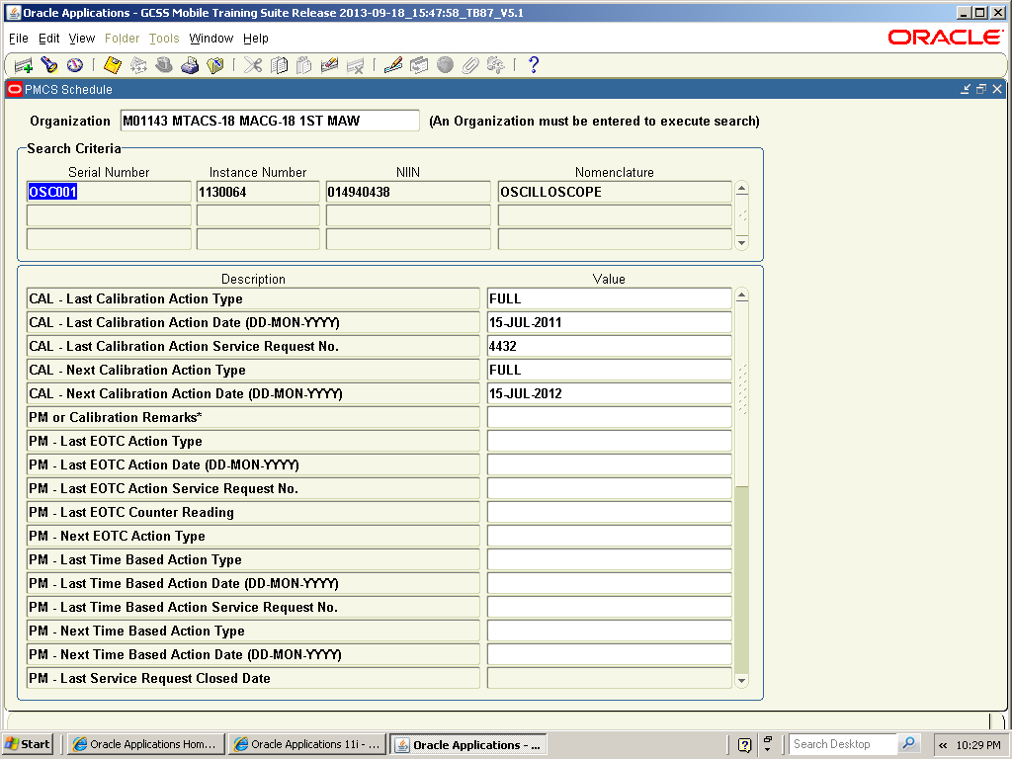
PM/CAL Scheduling Form
CAL Section

Slide 24
Practical Application
UPK MNT 201.04.02.04
  Managing CAL Schedules

Slide 25
Practical Application
UPK MNT 201.05.02.02
  Managing IB Sub-Item Instances

Slide 26
Calibrations Program
Questions ?

Slide 27
PM/CAL Scheduling Form
PM/CAL Scheduling Form
1
3
2
2
3
Maintenance-PM
Service Request
Maintenance-CAL
Service Request
4
4
PM Report
Cal Report
Notes:
There are three parts to the PMCS process inside of GCSS-MC.
This is a visual depiction of these three parts of the GCSS PMCS function.
The Marines will have to know how to use all three parts to be successful
We need to stress that all three parts are necessary IOT make the system work for the Marines
Need to emphasize the importance of entering all necessary equipment on the PM/CAL scheduling form and establishing the baseline information.
It is critical that your Marines understand how these three components of PMCS inside GCSS-MC work together.
The process they need to understand:
All equipment is entered on the PM/CAL Scheduling form
A service request is created to record the PMCS
Information from the service request is transferred (automatically or manually to the PM/CAL Scheduling form
The PM/CAL Scheduling form pushes data to the PM Report

Slide 28
Calibration Service Request
GCSS-MC Maintenance-CAL SR will be used for recording calibrations per GPN 1-13
UM 4000-125 describes process to create parent-child relationships for TMDE
  Use GCSS-MC Serial Number Generator
CAL 2000 or other means are authorized if its not installed base trackable. Header information must match GCSS CAL report header information.

Slide 29
Calibration Service Request
Complete the Maintenance-CAL service request
Select Maintenance-CAL in the ‘type’ field
Evacuate the TMDE item to the calibration facility
Receive the TMDE item from the calibration facility
Set the ‘status’ field to CLOSED and save again
You must now manually transfer the Maintenance-CAL service request to the PM/CAL Scheduling form

Slide 30
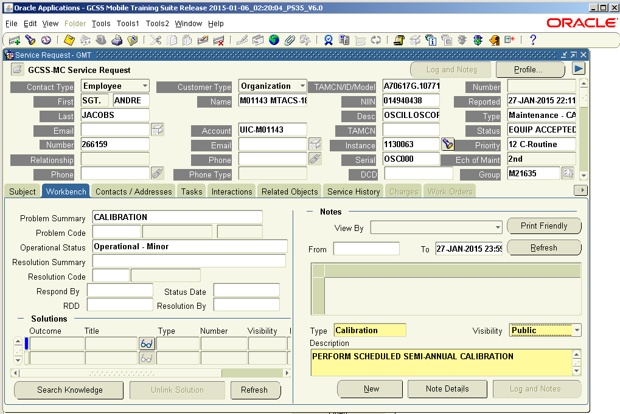
Calibration Service Request

Slide 31
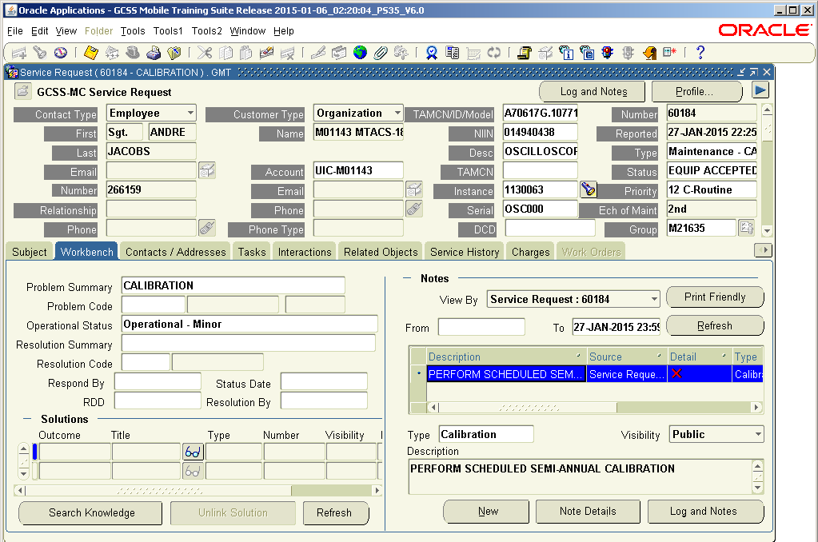
Calibration Service Request
Your service request has been created. You can make a copy and evacuate the item to the calibration facility.

Slide 32
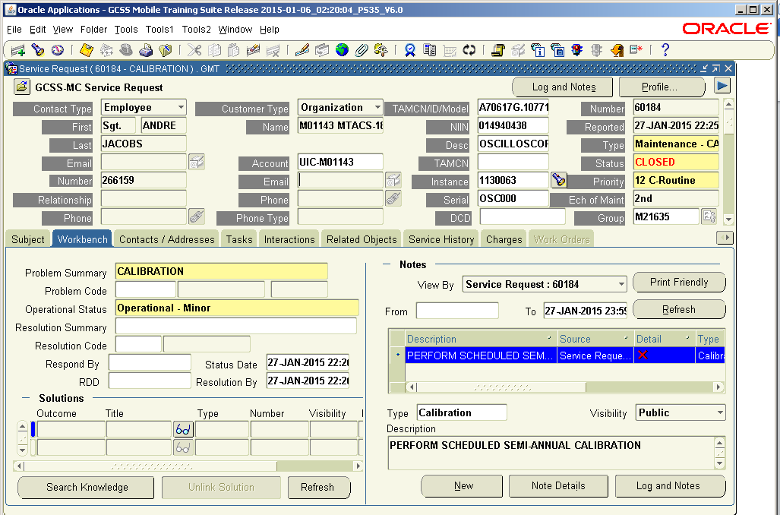
Calibration Service Request
You received the item back from the calibration facility. Set the ‘Status’ field to CLOSED and transfer the information to the PM/CAL Scheduling form

Slide 33
Calibrations Program
Questions ?

Slide 34
Practical Application
UPK MNT 201.04.02.04
  Managing CAL Schedules
Create a Calibration (Maintenance CAL) Service Request
Access and review PMCS/CAL Scheduling Form
  This is where Cal equipment statuses are updated

Slide 35
Practical Application
UPK MNT 201.05.02.02
  Managing IB Sub-Item Instances
Create a Calibration (Maintenance CAL) Service Request
Access and review PMCS/CAL Scheduling Form
  This is where Cal equipment statuses are updated

Slide 36
Calibrations Program
Questions ?

Slide 37
Calibration Report
GCSS-MC Discoverer User Report tracking calibration status for unit-loaded TMDE
Updated from PM/CAL Scheduling Form
Stoplight feature highlighting upcoming and past due calibration dates

Slide 38
PM/CAL Scheduling Form
PM/CAL Scheduling Form
1
3
2
2
3
Maintenance-PM
Service Request
Maintenance-CAL
Service Request
4
4
PM Report
Cal Report
Notes:
There are three parts to the PMCS process inside of GCSS-MC.
This is a visual depiction of these three parts of the GCSS PMCS function.
The Marines will have to know how to use all three parts to be successful
We need to stress that all three parts are necessary IOT make the system work for the Marines
Need to emphasize the importance of entering all necessary equipment on the PM/CAL scheduling form and establishing the baseline information.
It is critical that your Marines understand how these three components of PMCS inside GCSS-MC work together.
The process they need to understand:
All equipment is entered on the PM/CAL Scheduling form
A service request is created to record the PMCS
Information from the service request is transferred (automatically or manually to the PM/CAL Scheduling form
The PM/CAL Scheduling form pushes data to the PM Report

Slide 39
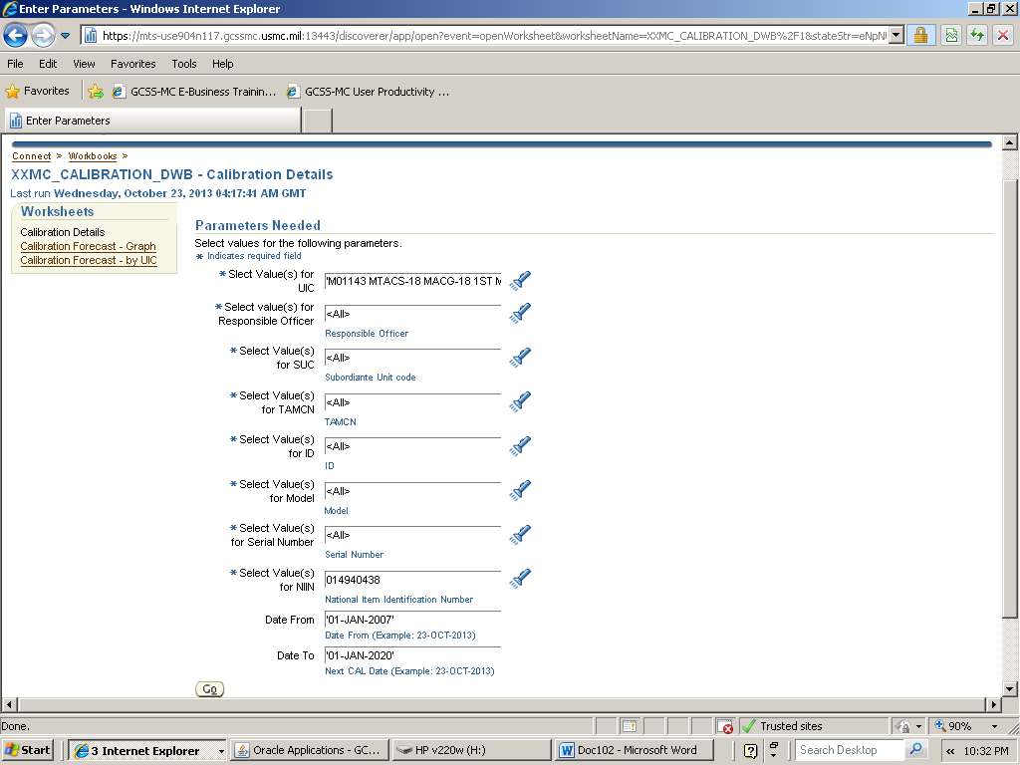
Calibration Report

Slide 40
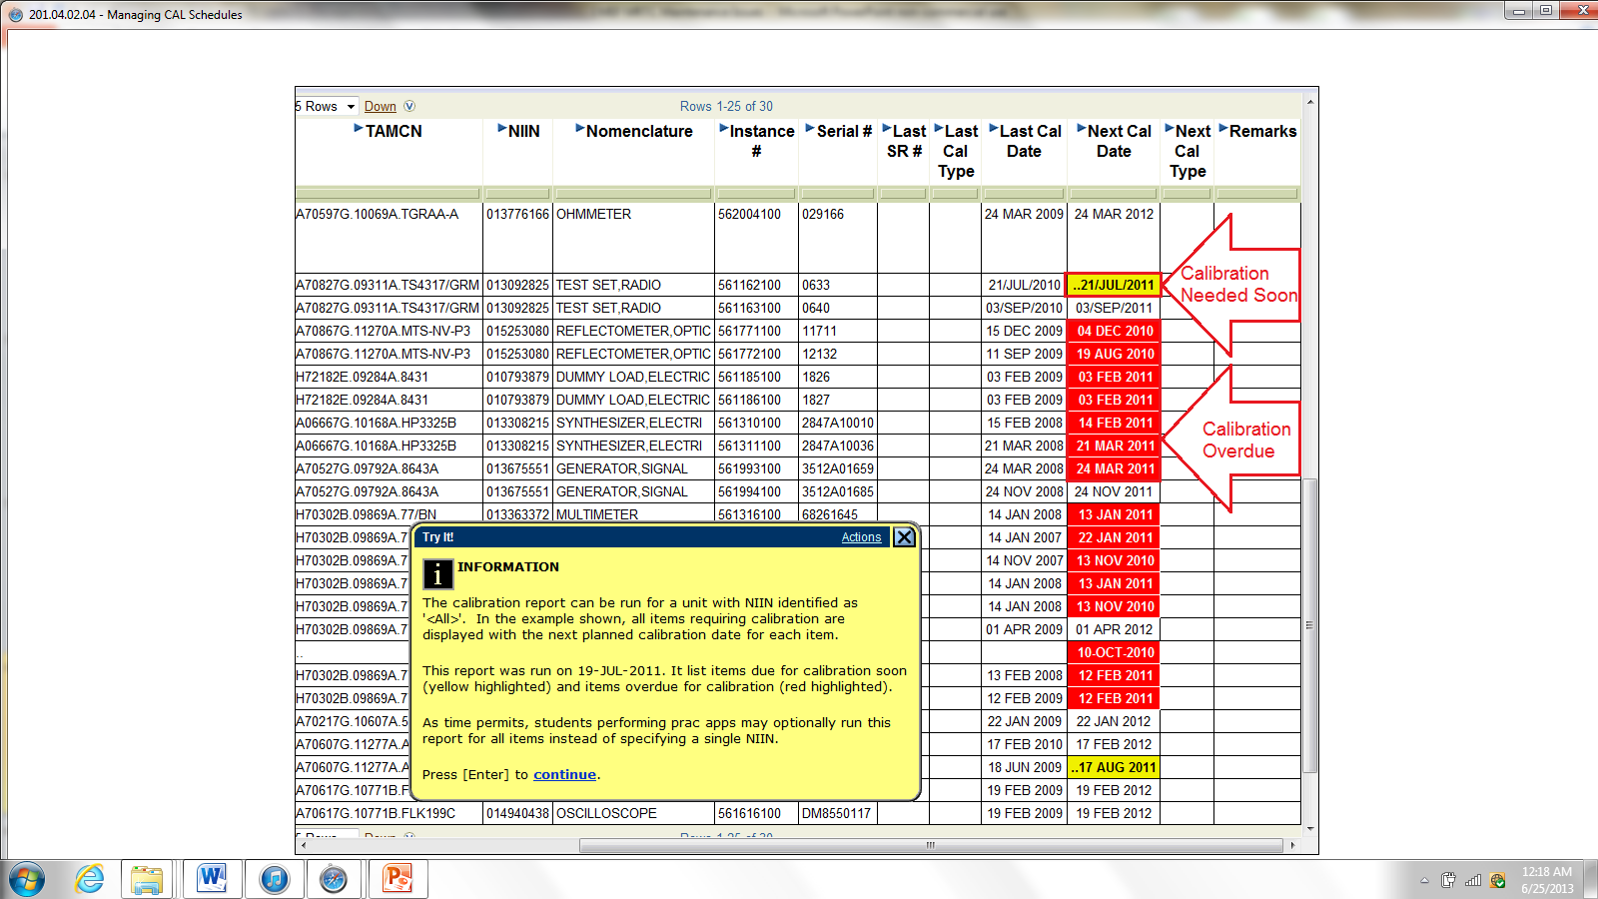
Calibration Report
Notes:
Note: For infantry battalions select the AAC-MXXXXX as the PUIC code. All other units should generally select the UIC R/U code. Good practice is to also select the AAC-MXXXXX to catch items that have been incorrectly classified.

Slide 41
Calibrations Program
Questions ?

Slide 42
External Calibration
Infantry Weapons Gauge Calibration Program (IWGCP)
Survey Instrument Calibration Program (SICP)
Parachutist’s High Altitude Oxygen Supply System (PHAOS)

Slide 43
Calibrations Program
Questions ?

Slide 44
Trends
Not scheduling and/or conducting calibrations
Not verifying SL-3 extracts, Installed Base, or IMO
ONLY using Cal 2000
Can’t find/pull GCSS-MC Calibration Report
Notes:
Units are not scheduling or conducting calibrations, just like PMCS, equipment must have calibration data initially entered via the PM/CAL Scheduling form or the Installed Base to establish a baseline and populate in the Cal Report. Units should verify their calibrations equipment requirements and item attributes with the appropriate SL-3 extracts, Installed Base, and the IMO.
Units are only using Cal2000 or locally generated tools to track calibrations. Per GPN 4-12, the only equipment that can be tracked this way authorized are infantry weapons gauges that are processed through the Infantry Weapons Gauge Calibration Exchange Program (IWGCEP).
Units do not know are or are not retrieving their GCSS-MC Calibrations Report to manage their calibrations programs.

Slide 45
Trends
Manual Process only (no Automated Reports)
Not conducting Annual Inventories
Data entered incorrectly on the PM/CAL Scheduling Form
  Example: 7-Ton on the Calibration report
Notes:
Units are not conducting annual inventories, which are required per MCO 4790.2C. There is not a defined format, but an annual inventory is still required.
Finally, units are not managing their calibration schedules to ensure that sufficient maintenance support is available to support operational requirements.

Slide 46
Issues
Cal Labs using incorrect procedures for courtesy SRs and custody transfers.
  Receiving unit prints the custody receipt (GPN 1-13)
LOGCOM cataloged some items incorrectly in GCSS-MC.
  Calibration Items either not identified as “Calibration Required,” “Installed Base Trackable,” “Serial Trackable,”
Parent / Child relationships are not established.
  Example: Common 24 & Torque Wrench
  Incorrect Item Attributes (LOGCOM) complicates process
Notes:
Cal Labs requiring Using Units to place the courtesy SR in Equipment Accepted status then print and bring a copy of the transfer of documentation (Custody Receipt) with them when inducting equipment. This is not in compliance with GPN 1-13.
Reference: GPN 1-13. 7.b.2.b. The maintenance activity will change the status of the SR to ‘Equip Accepted,’ save the SR and print a copy of the equipment's transfer of custody report and provide it to the preparing activity. Accomplishment of this step will auto-populate the date received in shop (DRIS). This action will be completed prior to the maintenance activity performing further steps in the maintenance cycle.
Item attributes are incorrectly loaded in the system. Items that should be labeled OTC-3, Installed Base Trackable, or Serial Trackable are not, and vice versa. Currently, submitting an IMO load through supply or contacting the appropriate Item Manager are the recommended procedures to correct improper item attributes.
Parent-Child relationships are not established in accordance with GPN-412. This process is complicated due to the previous issue regarding incorrect item attributes.
Finally, incorrect data is appearing on the calibrations report. This is generally due to entering information in the wrong section on the PM/CAL Scheduling Form.

Slide 47
Calibrations Program
Questions ?

Slide 48
Summary
Program Requirements
Responsibilities
Calibration Categories
PM/Cal Scheduling Form
Calibration Service Request
Calibration Report
External Calibration Programs

