Slide 1
Materiel Readiness Training Cell (MRTC)
Maintenance Management Supervisor Course
Modifications

Slide 2
Overview
The purpose of this class is to familiarize you with the Modification Control Program, how it is supported by GCSS-MC and what you need to know about it from a supervisor’s perspective.

Slide 3
Topics
Definition and Purpose
Source
Categories
Responsibilities
Initial Receipt of Equipment
New Modification Instructions
Modification Instruction Report
Advanced Modification Instructions Search
Trends & Issues

Slide 4
Definition of Modifications
Any changes in design or assembly which affect operation/configuration of equipment, improve equipment functioning, maintenance, or safety of use.

Slide 5
Purpose for Modifications
To change the design or assembly characteristics of equipment systems, end items, components, assemblies, subassemblies, or parts in order to improve equipment functionality, maintainability, reliability, and/or safety characteristics.

Slide 6
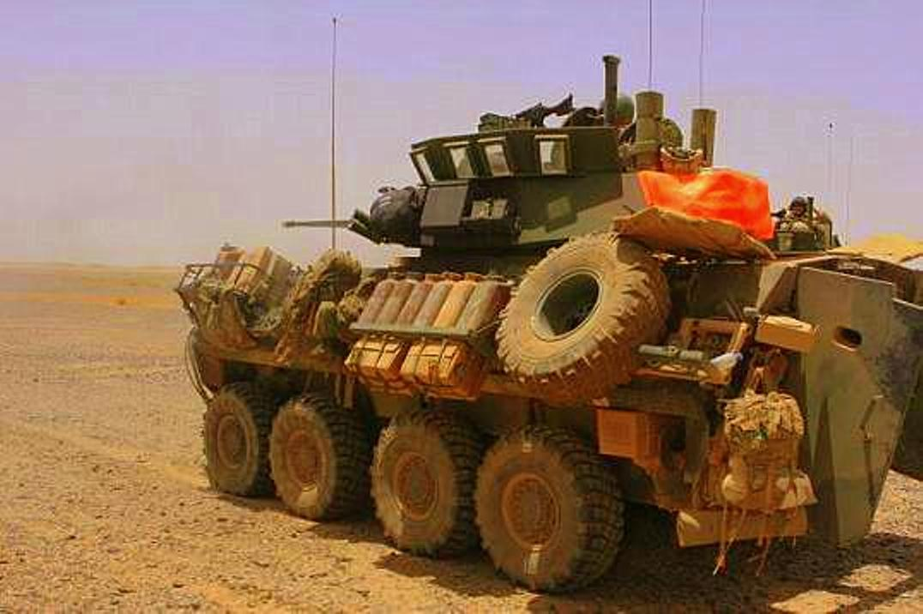
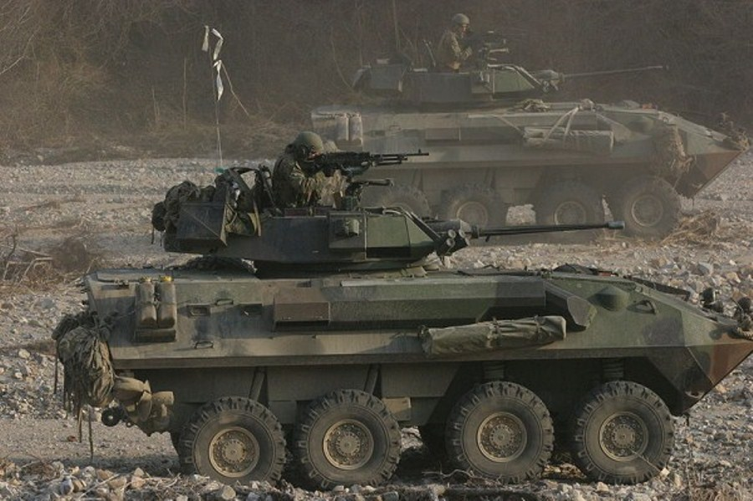
Modification Example
LAV-25 Gunners Blast Shield
With Modification
With Out Modification

Slide 7
Modifications
Questions ?

Slide 8
Where do they come from?
One source that leads to change is the Product Quality Deficiency Reports (PQDR) . PQDRs are field equipment improvement recommendations and beneficial suggestions that frequently establish the requirement for equipment modifications.

Slide 9
Modifications
Questions ?

Slide 10
Categories
Urgent
  Prevent death or serious injury
  Prevent major equipment damage
  Essential changes
  Equipment must be dead lined
  Completion date required

Slide 11
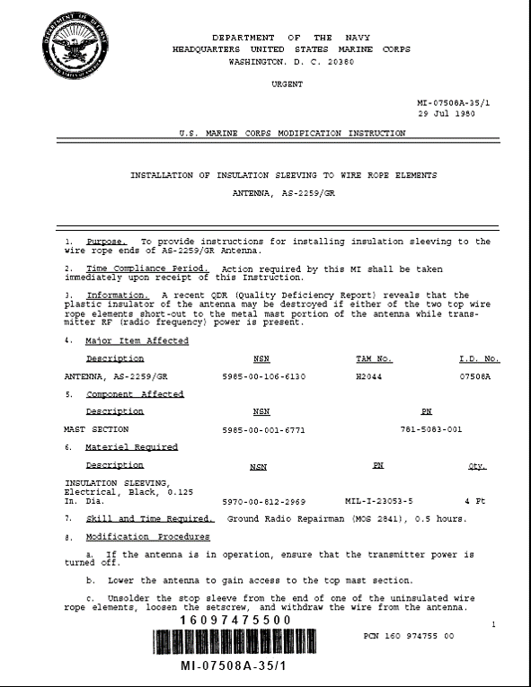
Categories

Slide 12
Categories
Normal
  Scheduling should be planned
  Normal MI required completion date :
    MI date + 1 year
  Using unit operational requirements
  Apply required modifications before deploying

Slide 13
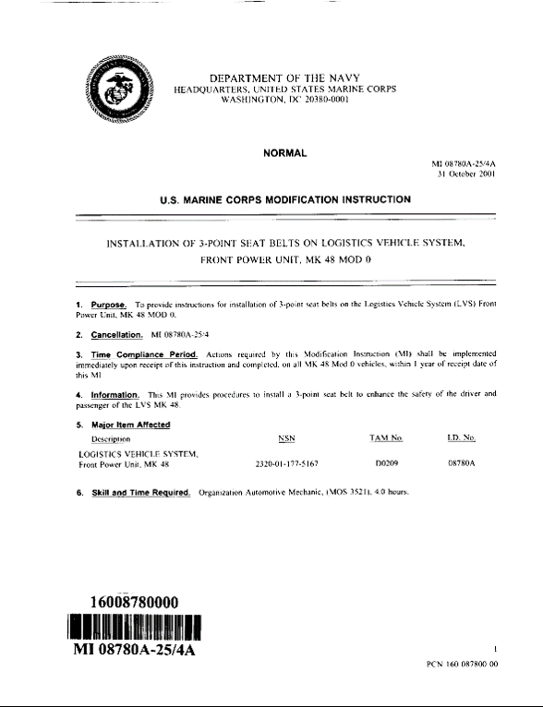
Categories

Slide 14
Modifications
Questions ?

Slide 15
Responsibilities
Commanders
  Establish a centralized program.
MMO
  Establish and maintain modification control records
  Establish Modification Control procedures
  Review Modification Control Program
Responsible Officer
  Maintain Modification Records
Supporting Maintenance Activity
  Determine Military Equipment modification requirements
  Validate Military Equipment modification status
  Perform Modification, if required

Slide 16
Modifications
Questions ?

Slide 17
Initial Receipt of Equipment
  Maintenance QC/Acceptance LTI
  Will determine if all required modifications have been properly completed
  If unable to make determination, evacuate equipment to an intermediate maintenance activity.
  Initiate an SR requesting missing modifications be applied
  Update the Modification records upon application / completion of the modification instruction.

Slide 18
Initial Receipt of Equipment
Researching
The SL-1-2 is still a source of researching modification instructions.
  Utilize the SL-1-2 to research published Modification Instructions by equipment identification number.
  The SL-1-2 is a listing for all equipment-associated publications.
    https://portal.logcom.usmc.mil/sites/pubs/default. aspx

Slide 19
Modifications
Questions ?

Slide 20
New Modification Instructions
Marine Corps Logistics Command (MARCORLOGCOM) introduces Modification Instructions within GCSS-MC
The Publication Control Number (PCN) is associated to the equipment NIIN within GCSS-MC Installed Base and identified with the Modification Instructions under the “Major Items Affected”
Once introduced, Modification Instructions are automatically associated to every serial number of the specified NIIN within the installed base

Slide 21
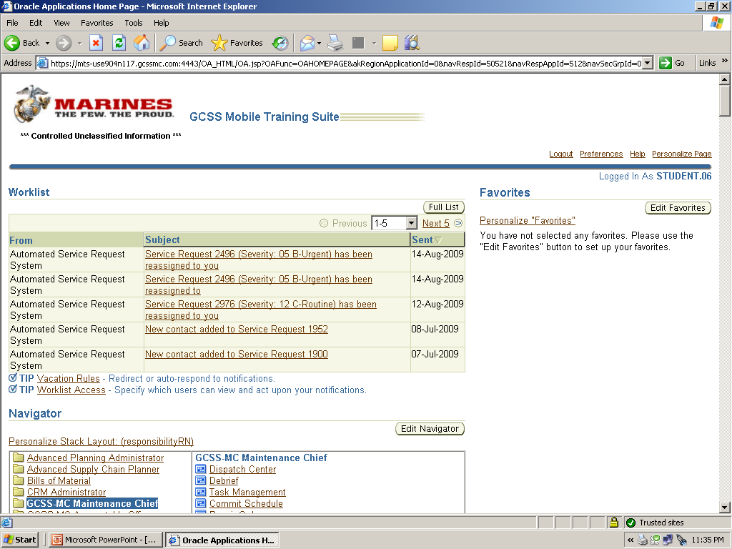
Modification Instructions in GCSS-MC:
Worklist Notification
The Responsible Officer (RO) receives notification of newly issued modification instructions here
Notes:
When Modification Instructions are released via GCSS-MC they should populate in the worklist notification of the Equipment RO. It is recommended that RO/Equipment Owners share their worklist notifications with both the Operations and Maintenance Chiefs for visibility purposes only. This allows them to start the process of ensuring the MI gets applied to the equipment. Modification Instructions can also be accessed by clicking on the Modification Instruction hyperlink via the worklist notifications on the home pace.

Slide 22
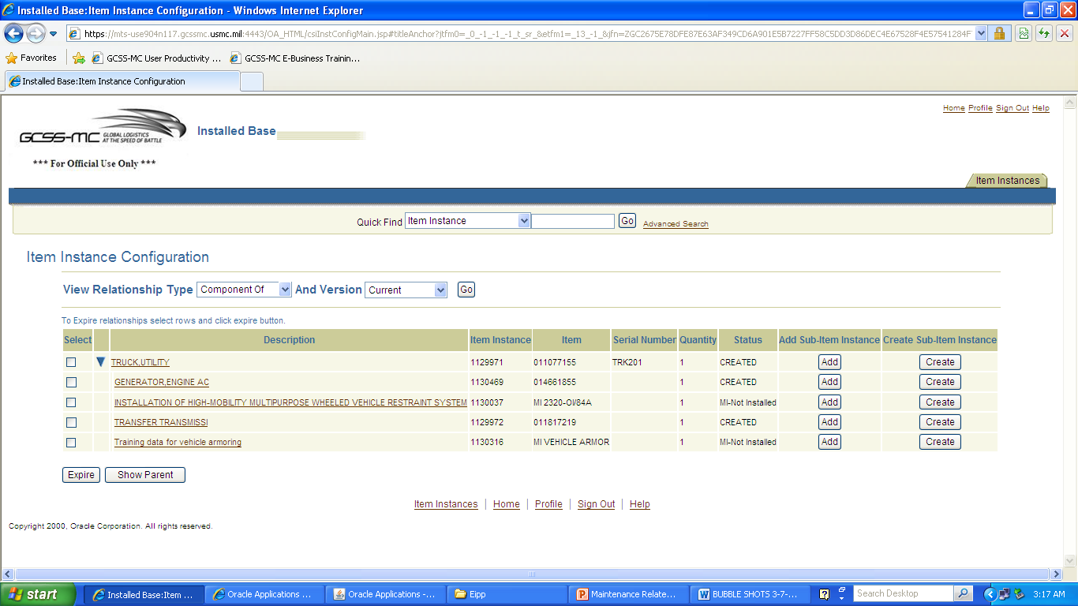
New Modification Instructions
MI Parent-Child Relationship
Short Title
MI #
Status
Notes:
This shows the correct Parent/Child configuration for an MI. Note that if Child components have Modification Instructions , they should be associated to the Child item, not the Parent Item, i.e. Modification Instructions firmware modification for a DAGR should be associated to the DAGR, not an LAV-25.

Slide 23
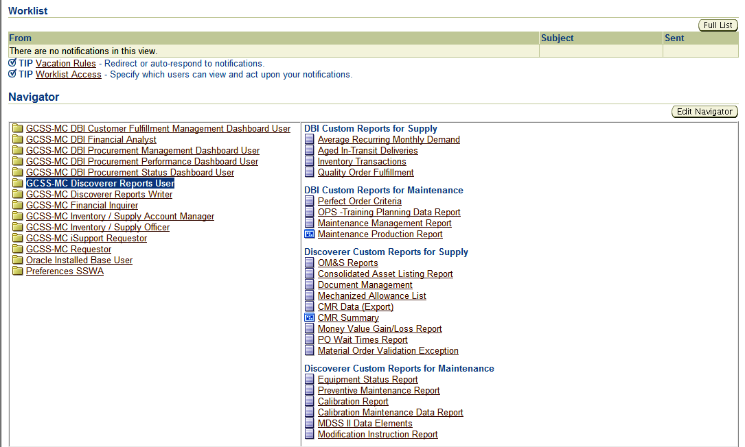
Modification Instruction Report
Modification Instruction Report
Notes:
To access the Modification Instructions Report you must have been assigned the role of GCSS-MC Discoverer Reports User by your UUAM. If you have this role select GCSS-MC Discoverer Reports User. Under the last group of choices “Discoverer Custom Reports for Maintenance” select the last choice ‘Modification Instructions Report’. This will take you to Modifications Instructions Report parameters page.

Slide 24
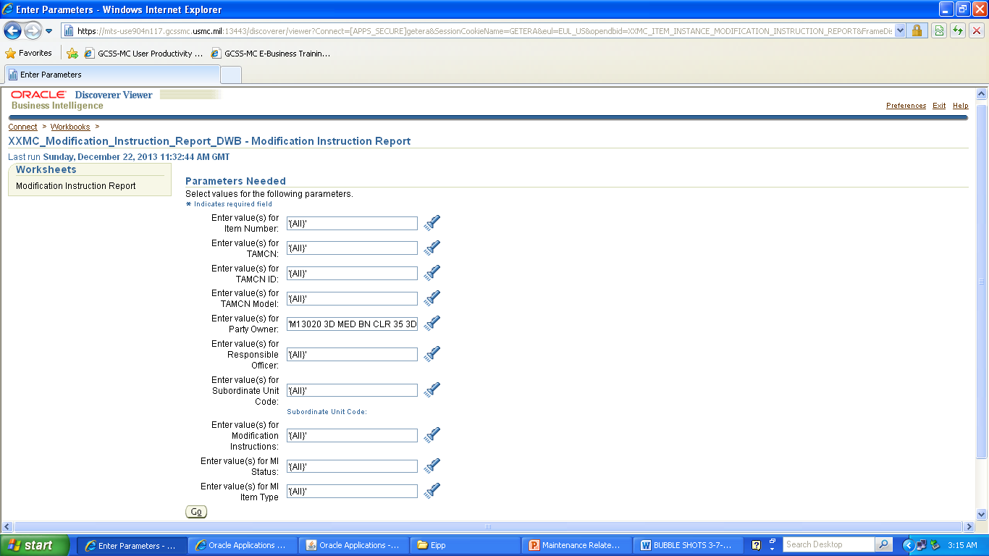
Modification Instruction Report
Notes:
On the reports parameters page you can customize your report based on user preference. For example, you can choose to use only the TAMCN, MI#, RO and status prameters. For our example we will select the Party Owner “M13020” using the flashlight icon. The flashlight icon allows users to select multiple entries from that field to be shown on the MI report.

Slide 25
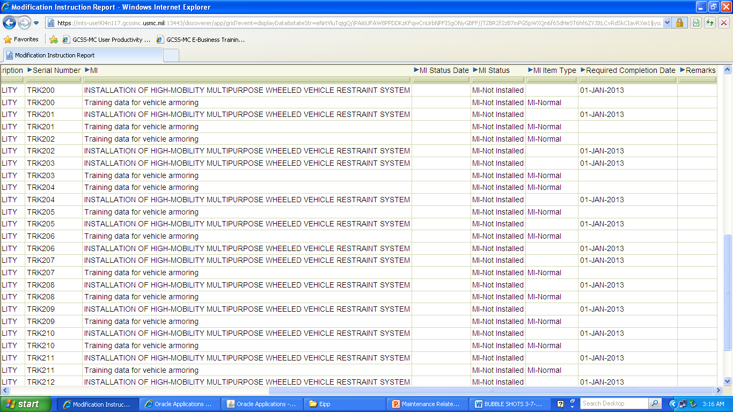
Modification Instruction Report
Three Key Items
MI Status
MI Item Type
Required Completion Date
Notes:
After generating the Modification Instructions (MI) report you can then review the results and export them as necessary. Areas of interest to the supervisor are MI Status Date, MI Item Type and Required completion date. All three of these areas are populated by LOGCOM. MIs are child components of the Military Equipment (ME) they are designated for. In this report you can see the ME type, Serial # and MI.
TRANSITION: There are occasionally issues with retrieving the MI Report, an alternative method of retrieving MI data for a unit is through the Installed Base.

Slide 26
Pulling a Modification Instructions Report
Modification Instruction Report
Notes:
To access the Modification Instructions Report you must have been assigned the role of GCSS-MC Discoverer Reports User by your UUAM. If you have this role select GCSS-MC Discoverer Reports User. Under the last group of choices “Discoverer Custom Reports for Maintenance” select the last choice ‘Modification Instructions Report’. This will take you to Modifications Instructions Report parameters page.

Slide 27
Pulling a Modification Instructions Report
Notes:
On the reports parameters page you can customize your report based on user preference. For example, you can choose to use only the TAMCN, MI#, RO and status prameters. For our example we will select the Party Owner “M13020” using the flashlight icon. The flashlight icon allows users to select multiple entries from that field to be shown on the MI report.

Slide 28
Pulling a Modification Instructions Report
Modification Instruction
Not Installed
Notes:
After generating the Modification Instructions (MI) report you can then review the results and export them as necessary. Areas of interest to the supervisor are MI Status Date, MI Item Type and Required completion date. All three of these areas are populated by LOGCOM. MIs are child components of the Military Equipment (ME) they are designated for. In this report you can see the ME type, Serial # and MI.
TRANSITION: There are occasionally issues with retrieving the MI Report, an alternative method of retrieving MI data for a unit is through the Installed Base.

Slide 29
Practical Application
UPK 201.05.02.03
  Managing Modification Instructions (MI) Updates
    Run the Modification Instruction Report
    Navigate to the Installed Base (IB) Item Instance of the assigned SR# and update the Modification Instructions (MI) status to “MI-Installed”
    Verify that the IB Item Instance for the assigned SR# reflects the updated MI-Status

Slide 30
Modifications
Questions ?

Slide 31
Modification Instructions
Advanced Modification
Instructions Search

Slide 32
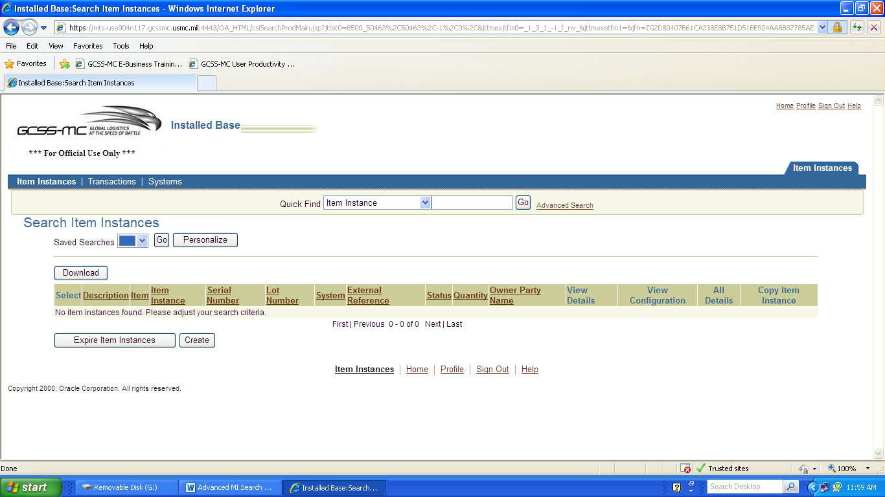
Advanced Search
Notes:
After selecting the appropriate role (Maintenance Chief, select the function of View Customer Item Instance. Select the Advanced Search.

Slide 33
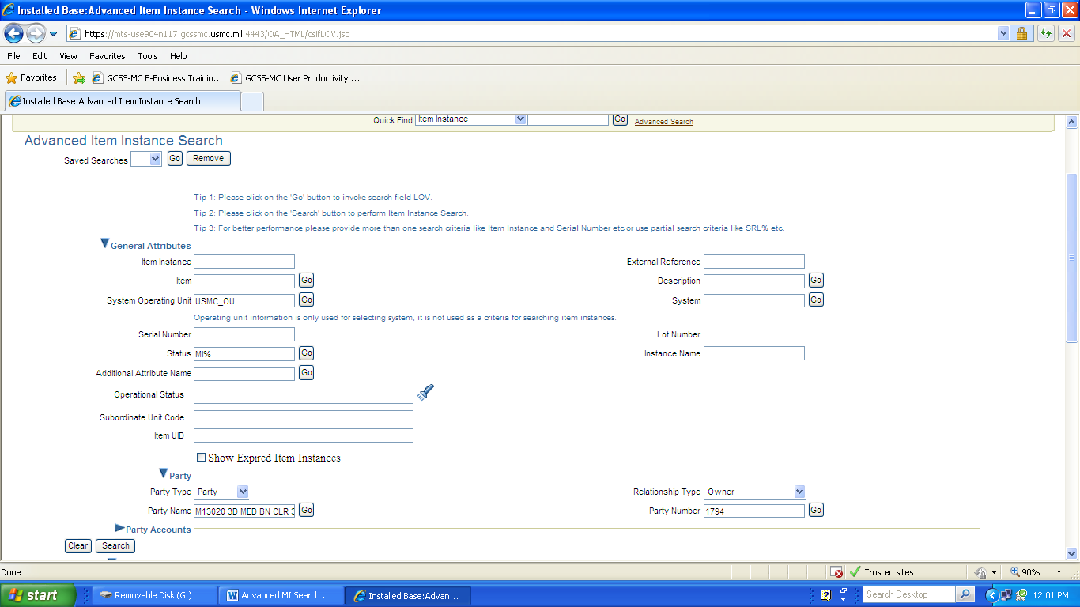
Advanced Search
Notes:
On the advanced search page you can search data based on user preference. For our example we will enter M13020% into the Party Name field then use the GO button. This runs a search that will return with the unit’s long name. In the Status field enter MI% then hit the search button in the lower left corner

Slide 34
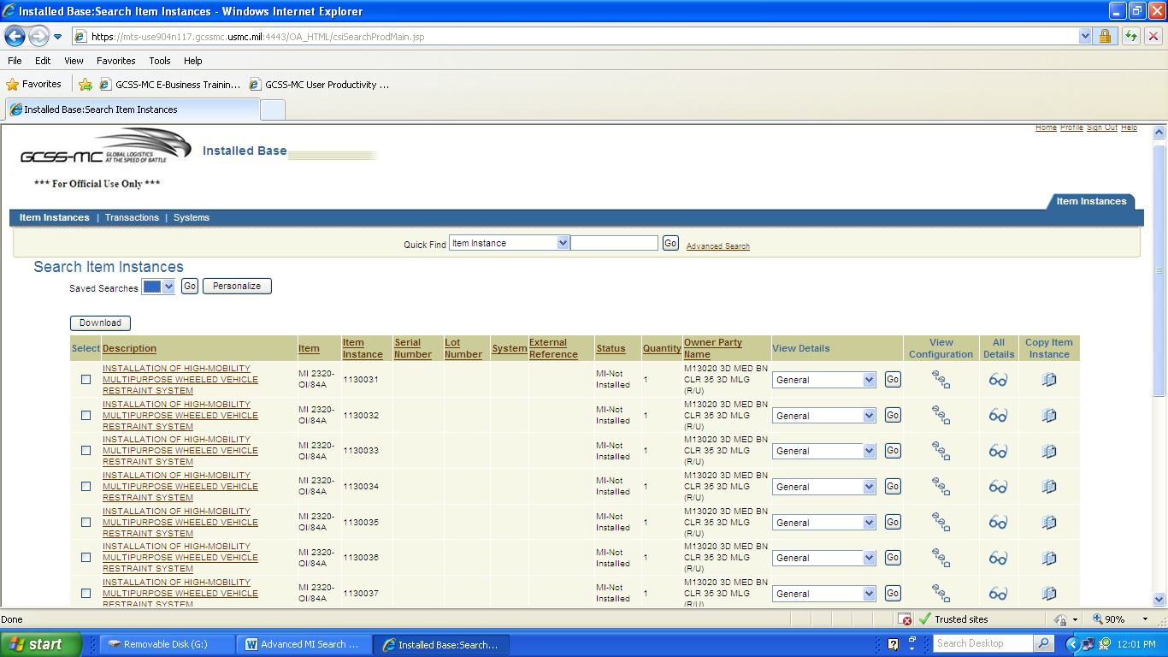
Advanced Search
Notes:
The results of your advanced search will populate and can be exported into your preferred document buy hitting the “Download” button.

Slide 35
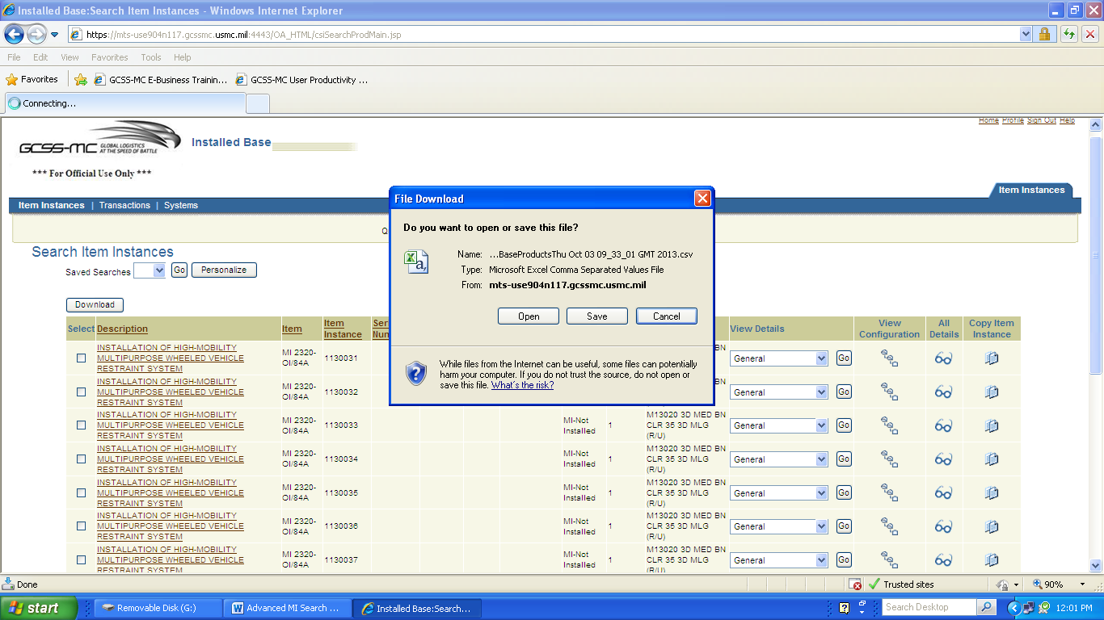
Advanced Search
Notes:
We have elected to download the data into a Microsoft Excel document, so we can have greater flexibility in filtering the data.

Slide 36
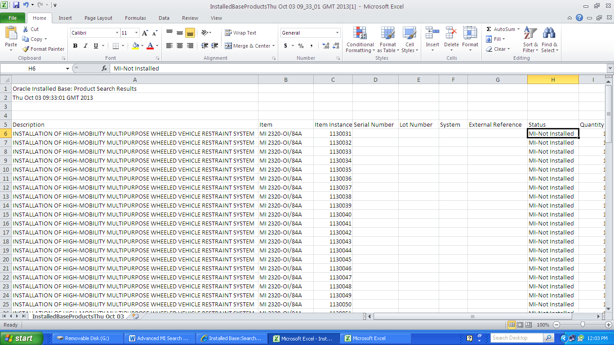
Advanced Search
Notes:
After opening the document, you can see all the data from the Installed Base Advanced Search you did. Microsoft Excel allows users to sort and filter in ways that discoverer reports does not.

Slide 37
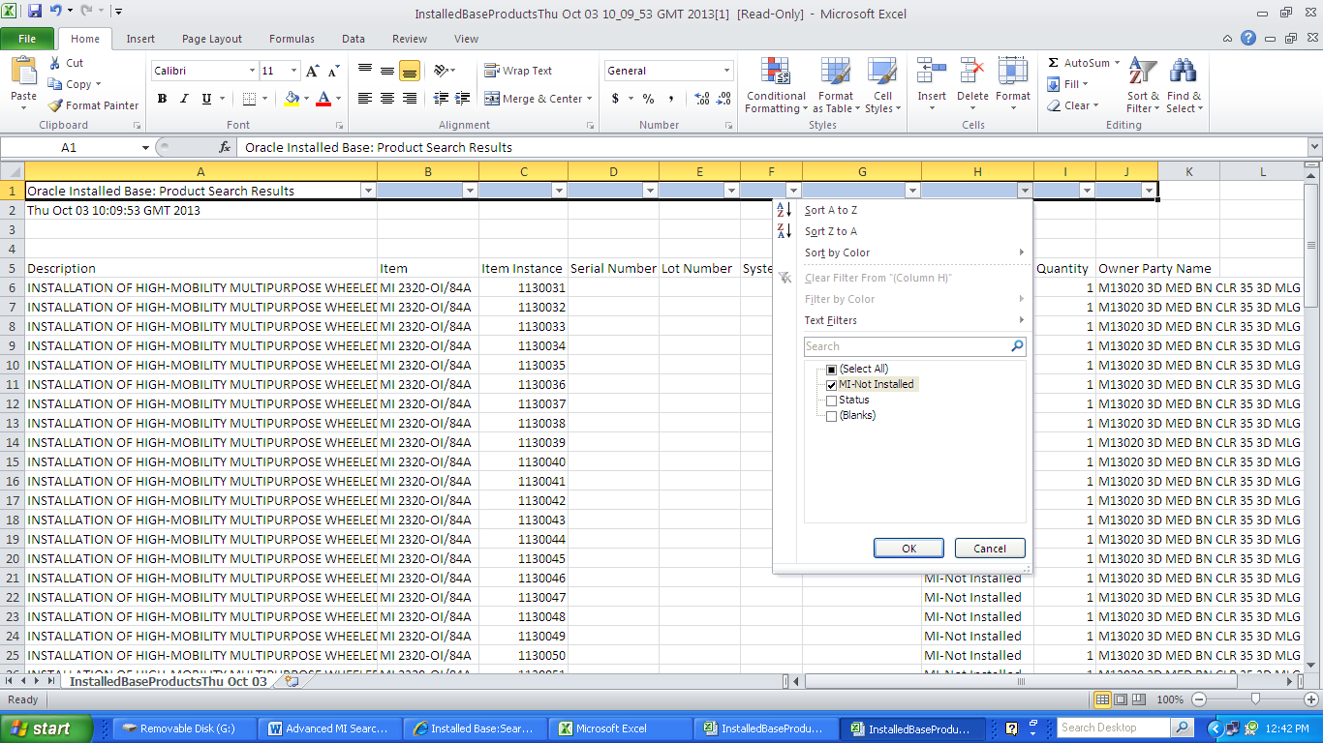
Advanced Search
Notes:
By selecting the drop down menu you can chose what data you want to appear in your exported report. Here we only selected “MI-Not installed” then clicked “OK”.

Slide 38
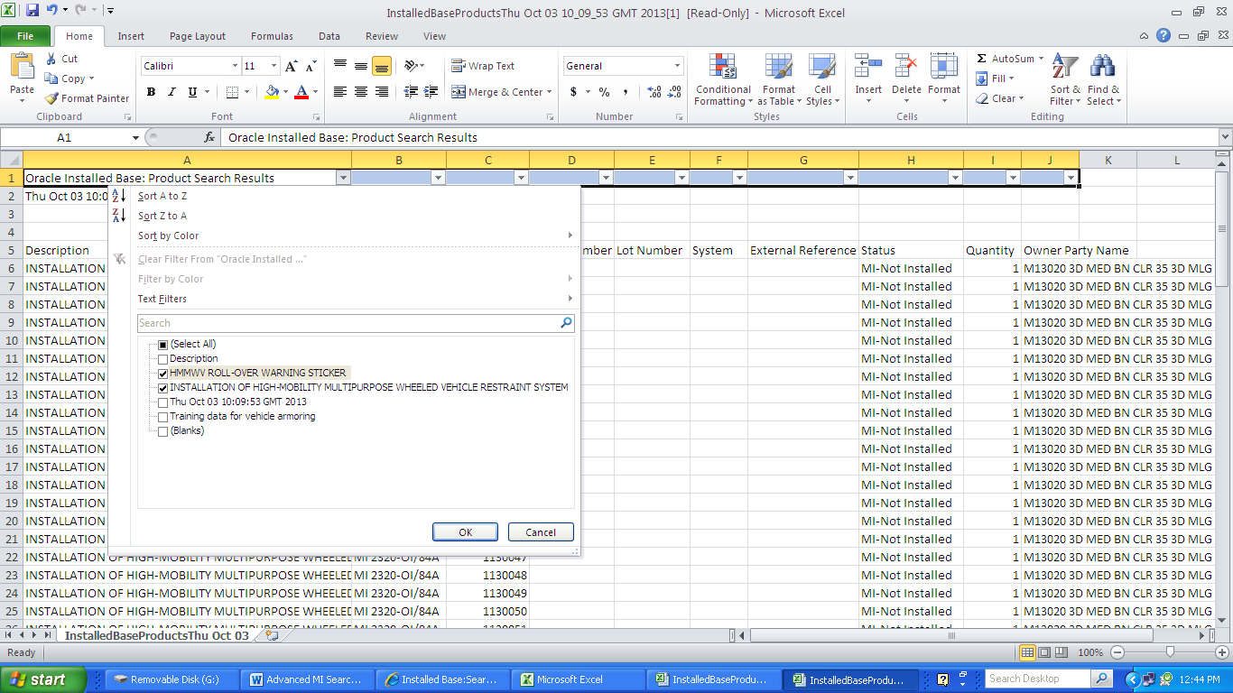
Advanced Search
Notes:
In the MI type column we selected only two (HMMWV Roll-Over Warning Sticker and Installation of High-Mobility Multipurpose Wheeled Vehicle Restraint System) then we selected “OK”.

Slide 39
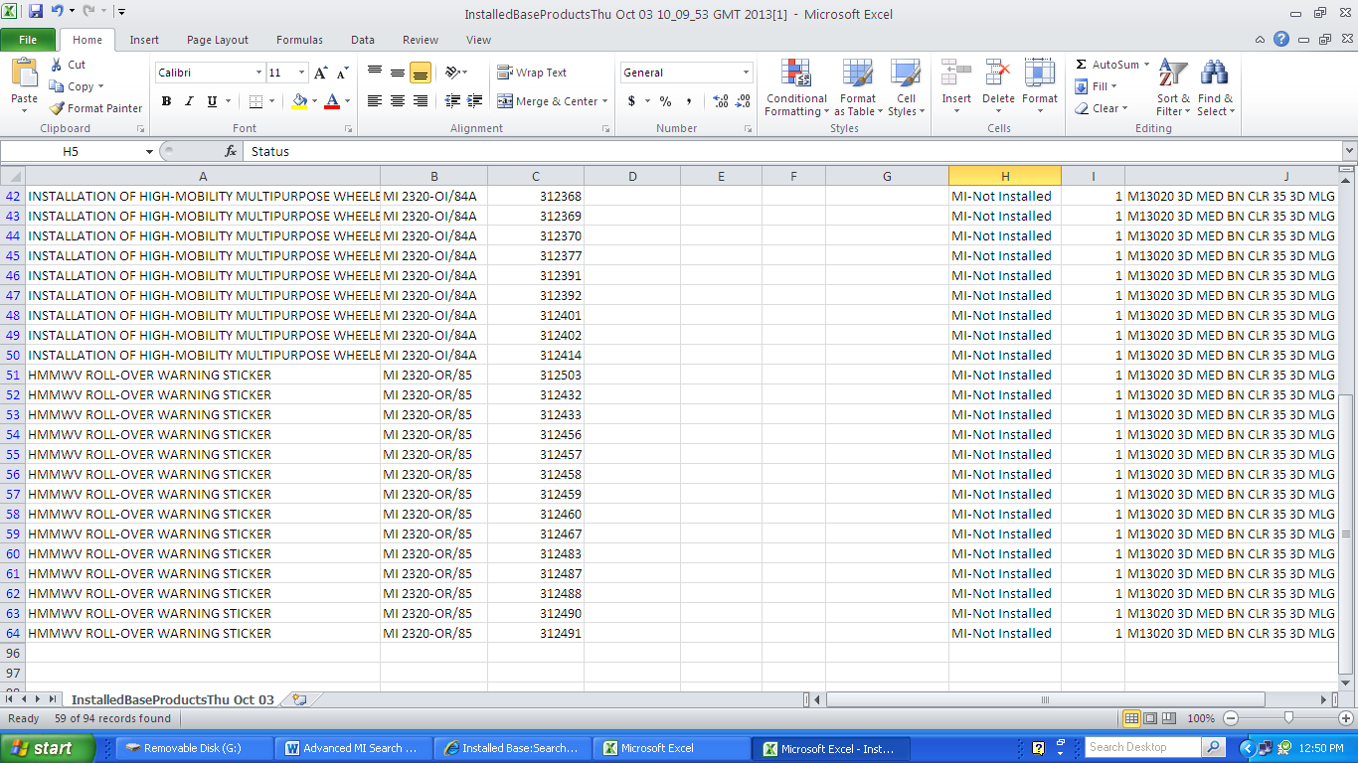
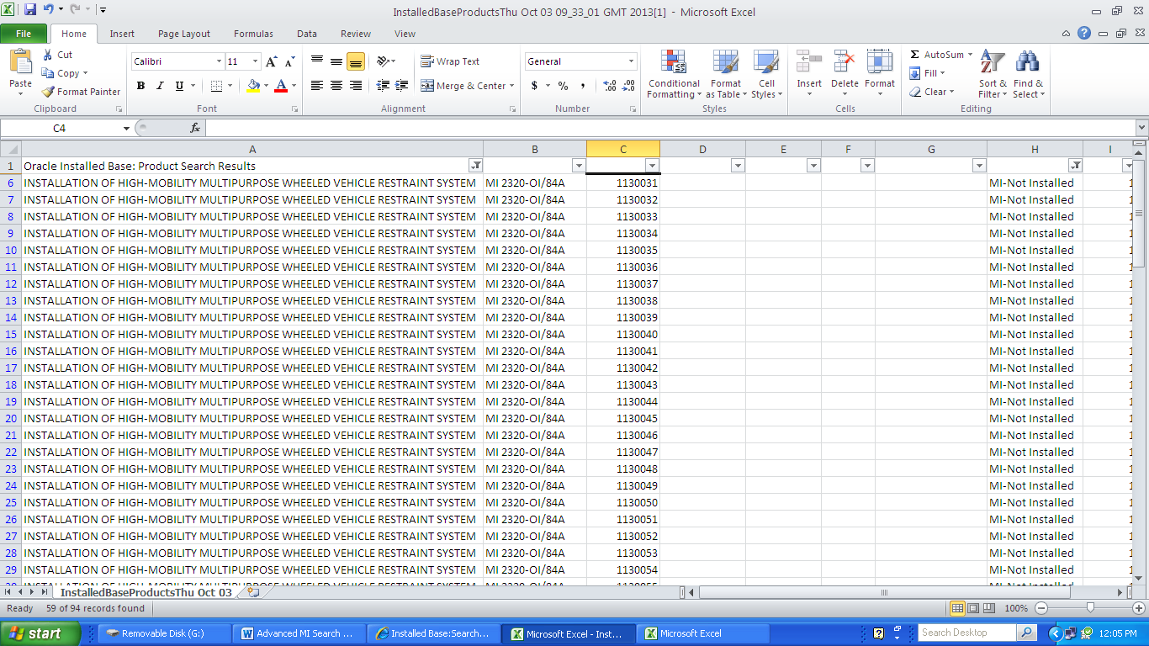
Advanced Search
Notes:
The result is a customized report based on out preference. At the bottom of the report you can see that based on our filter, 59 of the 94 records fits our criteria.

Slide 40
Modifications
Questions ?

Slide 41
Modification Instructions
Trends & Issues

Slide 42
Modification Trends
Units are not tracking and updating the status of Modification Instructions in GCSS-MC
Units still creating local modification instructions
Modification Instruction Parent-Child relationships
  Units expiring Modification Instructions due to lack of knowledge / training
    Creates Modification Instructions on NOSUC CMRs
ROs are not aware of the modifications for the equipment on their CMR
Notes:
First and foremost, units are not tracking and updating MIs in GCSS-MC. A good rule of thumb is that the work you do in the physical world MUST match the information in the electronic world.
Units are creating local modification instructions. This is prohibited and strictly controlled by LOGCOM. As new MIs are released, LOGCOM will be creating the Parent-Child relationships in the system for using units.
Units are expiring MI Parent-Child relationships, or Parent-Child relationships are incorrectly created. Units should reference GPN 4-12 and the “Policy Procedures and Management Requirements for Centralized Modification Control Record Program” for guidance on parent-child relationships, procedures for correcting incorrect MI data, and procedures for tracking legacy Modification Instructions that are not loaded into GCSS-MC.
Questions:
1. Are the appropriate modifications applied to my equipment?
Start with the modifications report
Or the advanced search as a starting point
Use the SL-1/2 extracts

Slide 43
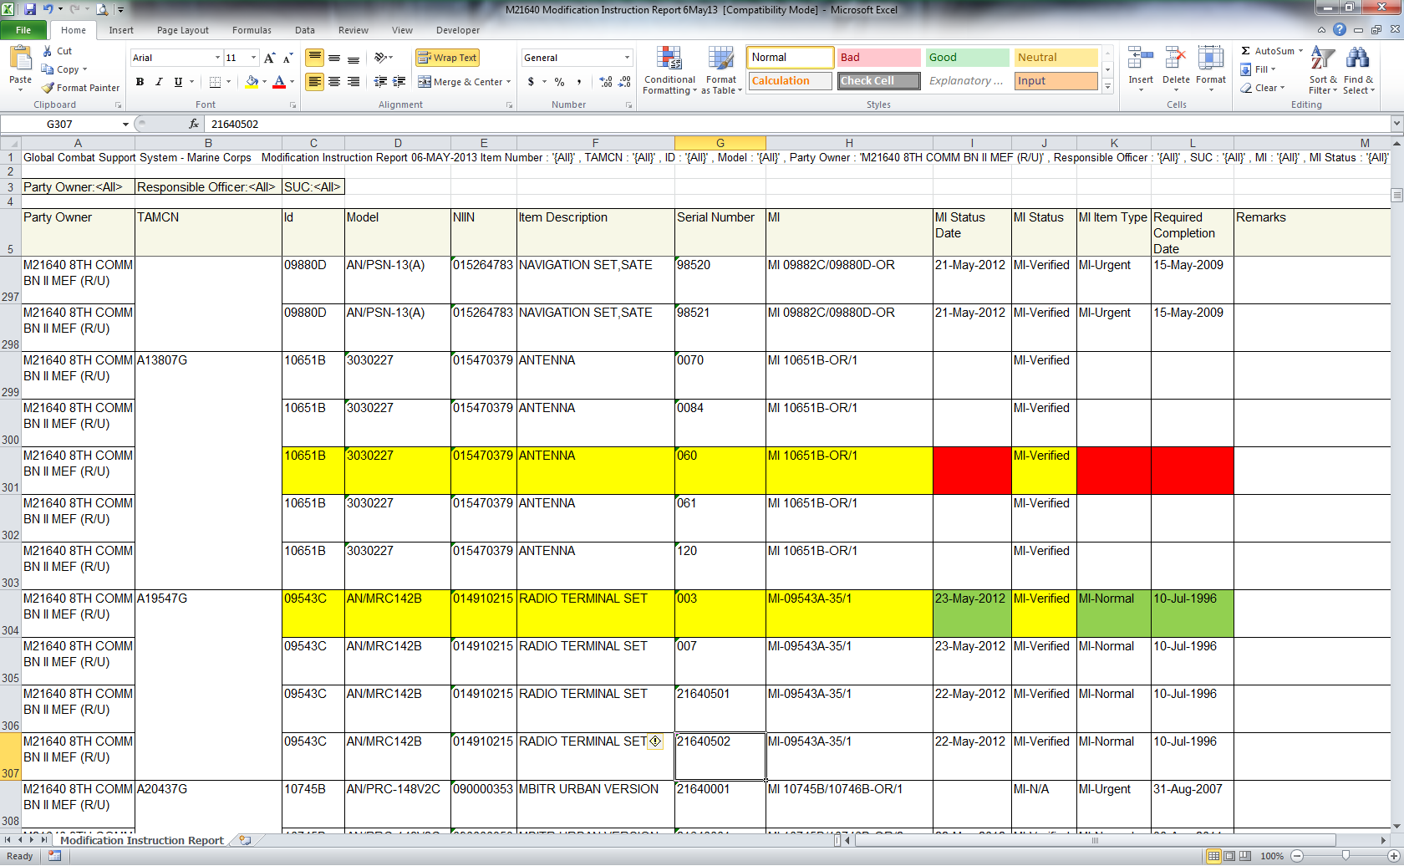
Creating Local
Modification Instructions
Owner Created MI
LOGCOM Created MI
Notes:
Here is an example of an exported MI report showing an MI that was correctly by LOGCOM and an incorrectly created MI by a using unit. If you refer back to those three key column headers (MI Status Date, MI Item Type and Required Completion Date) you can see that the MI created by LOGCOM has this information populate. The MI that was created by the using unit dose not have this information populated. The process of tracking MIs that do not show up in GCSS-MC is outlined in AMHS message DTG: 091558Z Jan 14 which discussed the method for tracking, and references MCO P4790.2C, GCSS-MC PROCEDURAL NOTICE (GPN) 4-12 and TM 4700-15H as source information.
AMHS message DTG: 091558Z Jan 14
3.D. USERS WILL NOT INTRODUCE (MANUALLY ADD) AN MI INTO THE INSTALLED BASE. WHEN
AN MI HAS BEEN PUBLISHED FOR MORE THAN 30 DAYS AND IS NOT PRESENT WITHIN THE
INSTALLED BASE; THE UNIT WILL SUBMIT A REMEDY TICKET REQUESTING THAT THE MI BE
LOADED.

Slide 44
MI Parent-Child Relationship
Modification (MI)
MI #
MI Status
Notes:
This shows the correct Parent/Child configuration for an MI. Note that if Child components have MIs, they should be associated to the Child item, not the Parent Item, i.e. MI firmware mod for a DAGR should be associated to the DAGR, not an LAV-25.

Slide 45

Correcting Locally-Created
Modification Instructions
Expire Items.
Notes:
The process shown here should be used only for MIs that were incorrectly configured at the using unit level. If an MI is incorrectly configured by LOGCOM, follow the procedures in the Policy Procedures and Management Requirements for Centralized Modification Control Record Program” message. Note, this does not get rid of the item, just breaks the parent-child relationship. Once you do this, the locally generated MI will now show up on the CMR. Units must ensure that MIs are promptly configured correctly to avoid creating property accounting issues.

Slide 46
Modification Instructions Issues
Modification Instructions
  Are not written correctly and format is not consistent across MARCORSYSCOM PMs
    Incorrect PCN assignment
    No cancellation statements
    Time compliance period doesn’t match category
    Incorrect Major Items Affected
    Incorrect recording instructions
Legacy Modifications not transferred to GCSS-MC
MI-Verified status changed on ME instead of MI
  Effects; cannot open a service request on the ME

Slide 47
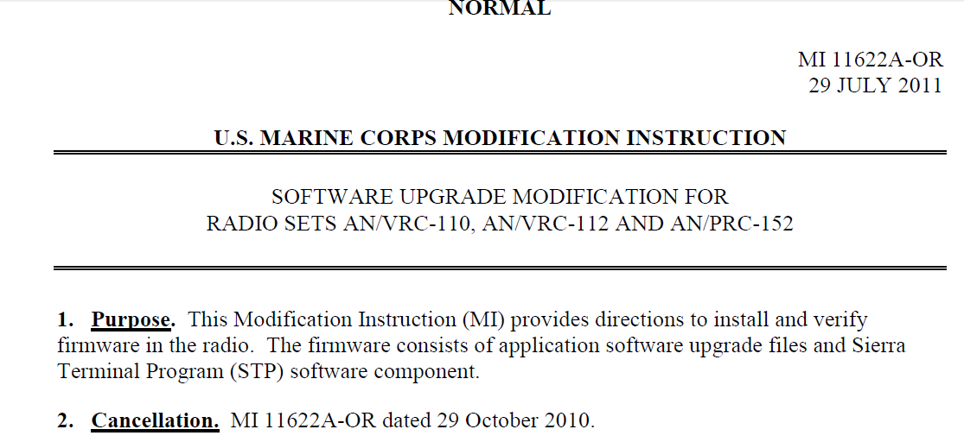
Short Title and PCN not Changed
The short title and PCN should have changed when this modification instruction was republished. Simply changing the date on a publication does not raise the appropriate flags to alert the user that something has changed.
Notes:
The short title and PCN should have changed when this modification instruction was republished. Simply changing the date on a publication does not raise the appropriate flags to alert the user that something has changed.

Slide 48
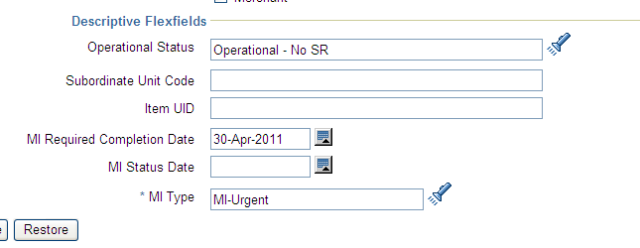
Effect in GCSS-MC
Required completion date should read 29 July 2012
Updated version of MI is Normal, not Urgent
Notes:
Required completion date should read 29 July 2012. Updated version of MI is Normal, not Urgent

Slide 49
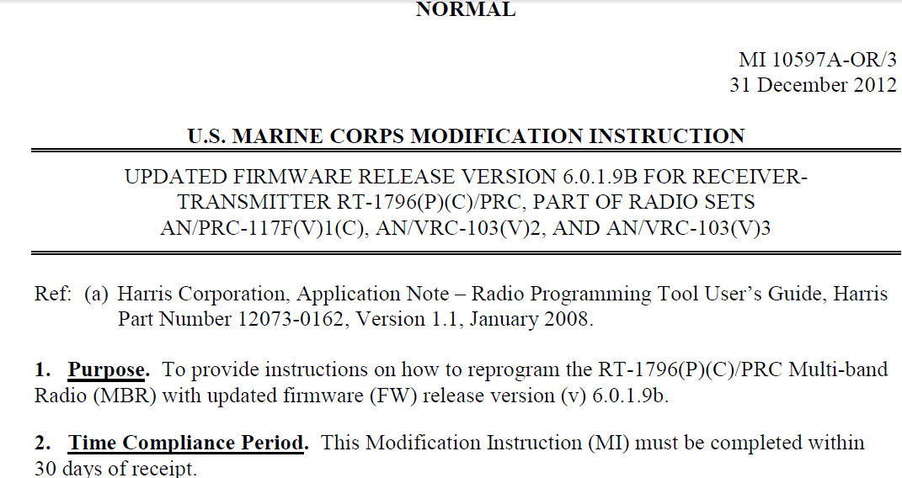
Modification Cancellation
This MI should have canceled the MI that released the previous firmware version. MIs for three different firmware versions are still resident in GCSS
30 day time compliance. Should this have been Urgent?
Notes:
This MI should have canceled the MI that released the previous firmware version. MIs for three different firmware versions are still resident in GCSS. 30 day time compliance. Should this have been Urgent?

Slide 50
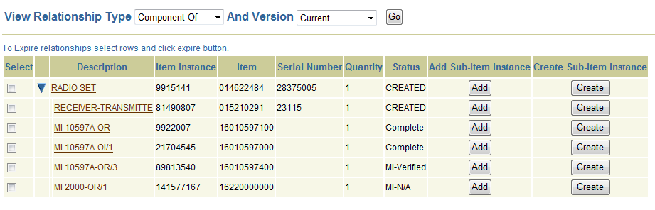
Modification Cancellation
MIs for three versions of the firmware are shown in GCSS. A radio can only have one version of the firmware loaded. These MIs were all released without cancellation statements. What is the policy for removing cancelled or superseded MIs from GCSS-MC?
Firmware release 6.0
Firmware release 6.0.1.10
Firmware release 6.0.1.9B
Notes:
MIs for three versions of the firmware are shown in GCSS. A radio can only have one version of the firmware loaded. These MIs were all released without cancellation statements. What is the policy for removing cancelled or superseded MIs from GCSS-MC?

Slide 51
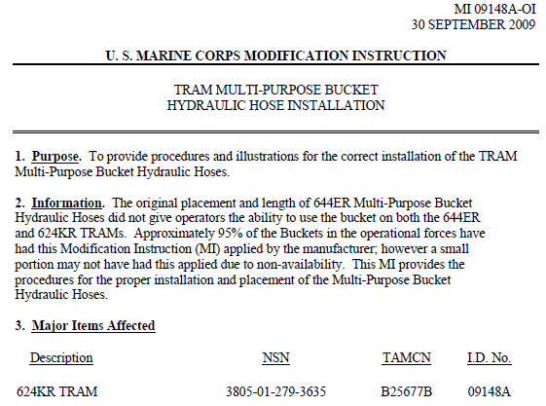
Modifications with wrong NIIN
This MI applies to the new TRAM but is only found under the old TRAM (B2567) in GCSS
New TRAM
Old TRAM
Notes:
This MI applies to the new TRAM but is only found under the old TRAM (B2567) in GCSS

Slide 52
Incorrect Recording Instructions
MI Recording instructions still reflect legacy procedures
  MI published on 31 October 2013
    “Ensure the appropriate records are updated in accordance with the current edition of TM 4700-15/1 or as specifically set forth in this instruction”
MI 2000-OR/2 published on 30 August 2013
  Applies only to radio sets deployed in support of OEF
  MI associated with all 19,129 radio sets in GCSS-MC

Slide 53
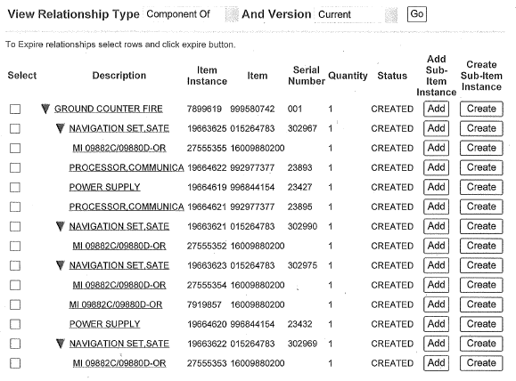
MI Parent-Child Relationship
The same MI is accounted for 5 times in this configuration, 4 times for the individual DAGRs that the modification is applied to and 1 time for the PEI. The instance associated to the PEI tells us nothing because we don’t know which DAGR it refers to.
MIs associated to Component
MI associated to PEI
Notes:
Here is an example of an incorrectly configured relationship. There are four MIs correctly associated to the DAGRs, and one MI configured to the PEI.

Slide 54
Centralized Modification Control Records
Modification Instructions not in the IB
  Manually track using GCSS-MC Modification Instruction report format until Modification Instruction loaded in IB
  Applies to EKMS (COMSEC) mods w/o published Modification Instruction
Modification Instruction discrepancies
  Submit NAVMC 10772
  Incorrect Parent-Child Relationships
  Do not Expire (or Retire) Modifications
  Do not manually add (create) Modifications in IB

Slide 55
Summary
Definition and Purpose
Source
Categories
Responsibilities
Initial Receipt of Equipment
New Modification Instructions
Modification Instruction Report
Advanced Modification Instructions Search
Trends & Issues

Slide 56
Modifications
Questions ?

